Slide 1
Creating Compelling Scientific Posters

Slide 2
Scientific posters
Are enlarged, graphical presentations of research data
Provide rapid and reliable publications
Note: the abstract is the reference
Include different levels of information
Are presented in a variety of designs and formats
Can compel the viewer to:
read further
walk away
The aim of these training slides is to demonstrate the good and bad elements of poster development and to provide guidance on how to make your posters compelling to the reader

Slide 3
Examples of good and bad posters
Some posters are GOOD

Slide 4
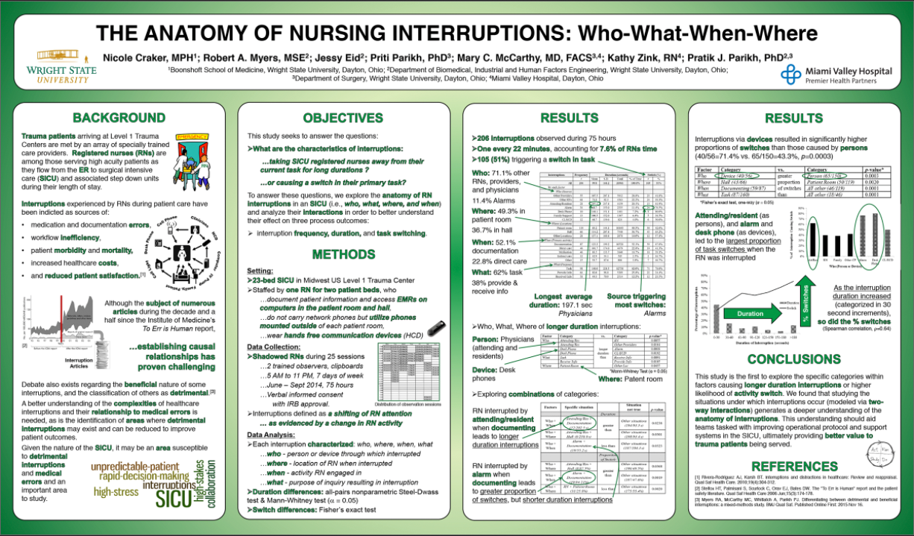
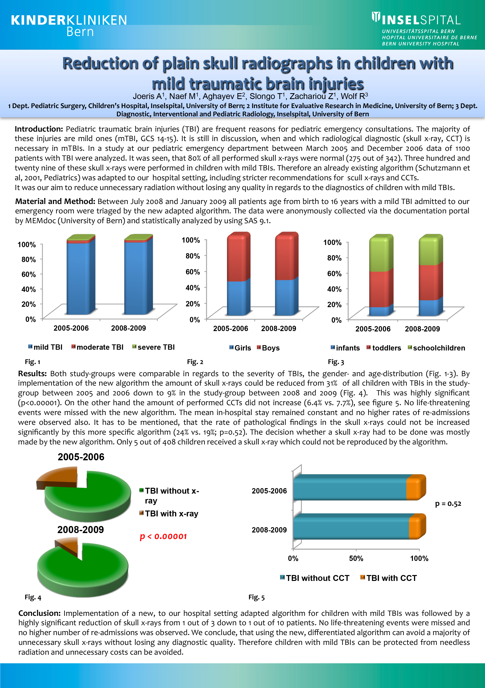
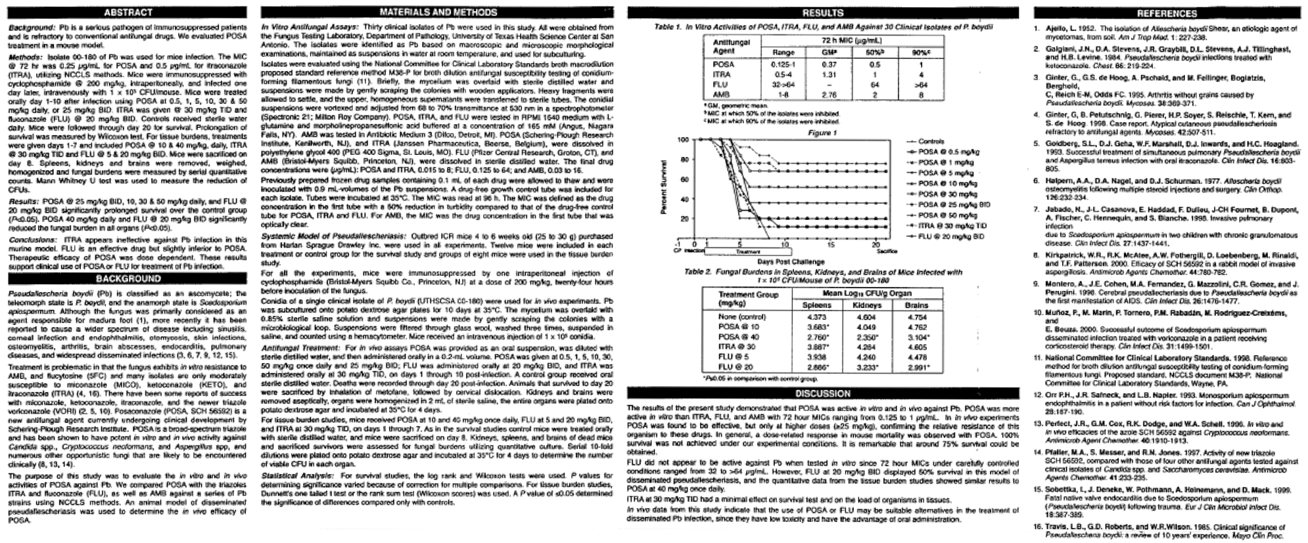
Examples of good and bad posters
Many more are BAD

Slide 5
What makes a GOOD poster?
Compelling data
Simple, easy to read text
Creative use of tables, figures and graphics
Feeling of space

Slide 6
What makes a BAD poster?
Type too small or hard to read
Too much unnecessary data
Confusing organization
Lack of headings
Lack of tables, figures, graphics
The information is not newsworthy

Slide 7
First ask
What did the abstract say?
What are the most important/interesting results?
What is the target audience (reader) interested in?
How can I visually present my research?
What text can I replace with tables and figures?

Slide 8
Approach to writing
Most importantly, respect target length (600-900 words)
Use abbreviations
Use tables and figures to replace words
Write short sentences
Use bullets
Remove non-essential information
Write in defined sections

Slide 9
1. Title
Short and draws interest
Vacuolated polymorphonuclear neutrophils on a standard peripheral blood smear directly correlate with lactate levels in hemorrhagic shock trauma patients: a case control study.
23 words
Correlation between the presence of vacuolated polymorphonuclear neutrophils and lactate levels in hemorrhagic shock trauma patients.
16 words non-essential information removed
Correlation between vacuolated PMN presence and lactate levels in hemorrhagic shock trauma patients
13 words abbreviation used

Slide 10
2. Abstract
Only include if it is a congress requirement, as it takes up precious space
In this example, the abstract is 314 words, out of a total of 968 (32.4%)
Either remove it, if it is not a congress requirement or reduce to a minimum font (the congress attendees will already have a copy in the abstract book)

Slide 11
3. Introduction
Brief and relevant
Limit the information
Ask the pertinent question
Present tense
Short sentences
Bullets
In this example, the introduction is long and difficult to follow.
See how to improve in the next slide.

Slide 12
3. Introduction – Example
Pediatric traumatic brain injuries (TBI) are frequent reasons for pediatric emergency consultations. The majority of these injuries are mild ones (mTBI, GCS 14-15). It is still in discussion, when and which radiological diagnostic (skull x-ray, CCT) is necessary in mTBIs. In a study at our pediatric emergency department between March 2005 and December 2006 data of 1100 patients with TBI were analyzed. It was seen, that 80% of all performed skull x-rays were normal (275 out of 342). Three hundred and twenty nine of these skull x-rays were performed in children with mild TBIs. Therefore an already existing algorithm (Schutzmann et al, 2001, Pediatrics) was adapted to our hospital setting, including stricter recommendations for scull x-rays and CCTs.
It was our aim to reduce unnecessary radiation without loosing any quality in regards to the diagnostics of children with mild TBIs.
140 words
Most pediatric traumatic brain injuries (TBI), requiring pediatric emergency consultation, are mild (mTBI, GCS 14-15)
When and which radiological diagnostic procedures are indicated, are debatable
Between March 2005 and December 2006, of 342 skull x-rays in 1100 TBI patients, 329 were in mTBI patients and 275 (80%) were normal
We adapted a pre-existing algorithm (Schutzman et al Pediatrics 2001;107:983-93), with stricter recommendations for skull x-rays and CCTs, to reduce unnecessary radiation exposure in our patients
75 words write short sentences, use bullets, remove non-essential information

Slide 13
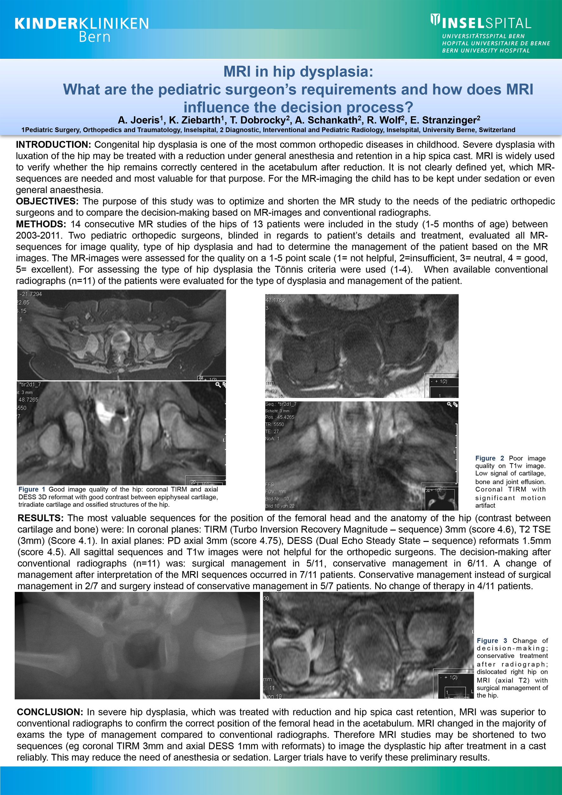
4. Objectives and Methods
Include only essential information
[for example, design, study population, sample, treatments, assessments, statistics]
Write short sentences
Structure using sub-headings and bullets
In this example, the methods are concise, but are difficult to assimilate.
See how to improve in the next slide.

Slide 14
4. Objectives and Methods – Example
Objectives: The purpose of this study was to optimize and shorten the MR study to the needs of the pediatric orthopedic surgeons and to compare the decision-making based on MR-images and conventional radiographs.
Methods: 14 consecutive MR studies of the hips of 13 patients were included in the study (1-5 months of age) between 2003-2011. Two pediatric orthopedic surgeons, blinded in regards to patient’s details and treatment, evaluated all MR-sequences for image quality, type of hip dysplasia and had to determine the management of the patient based on the MR images. The MR-images were assessed for the quality on a 1-5 point scale (1=not helpful, 2=insufficient, 3=neutral, 4=good, 5=excellent). For assessing the type of hip dysplasia the Tönnis criteria were used (1-4). When available conventional radiographs (n=11) of the patients were evaluated for the type of dysplasia and management of the patient.
Objectives: 32 words Methods: 113 words
Objectives:
To optimize MR procedures in-line with pediatric orthopedic surgeons needs
To compare decision-making based on MR-images and conventional radiographs
Methods:
Samples: 14 consecutive MR hip studies from 13 patients (aged 1-5 months), between 2003-2011
Assessments:
Two pediatric orthopedic surgeons (blind with respect to patient details and treatment)
Evaluated MR-sequences for
image quality on 5 –point scale [1=not helpful, 2=insufficient, 3=neutral, 4=good, 5=excellent)
hip dysplasia type using Tönnis criteria
Proposed patient management (based on images)
Evaluated conventional radiographs where available (n=11) for dysplasia type and patient management
Objectives: 19 words Methods: 66 words

Slide 15
5. Results
State results factually without commentary or interpretation
Direct the reader to the tables and figures
Write short sentences
Structure using sub-headings and bullets
Keep tables and figures near the relevant text
In this example, the results in the text complement the tables and figures, but the paragraph is a solid block of text and some of the sentences are very long.
Consider using sub-headings or bullets and moving the relevant text adjacent to the tables and figures to help the reader navigate.
See how to improve in the next slide.

Slide 16
5. Results – Example
Both study-groups were comparable in regards to the severity of TBIs, the gender- and age-distribution (Fig. 1-3). By implementation of the new algorithm the amount of skull x-rays could be reduced from 31% of all children with TBIs in the study-group between 2005 and 2006 down to 9% in the study-group between 2008 and 2009 (Fig. 4). This was highly significant (p<0.00001). On the other hand the amount of performed CCTs did not increase (6.4% vs. 7.7%), see figure 5. No live-threatening events were missed with the new algorithm. The mean in-hospital stay remained constant and no higher rates of re-admissions were observed also. It has to be mentioned, that the rate of pathological findings in the skull x-rays could not be increased significantly by this more specific algorithm (24% vs. 19%; p=0.52). The decision whether a skull x-ray had to be done was mostly made by the new algorithm. Only 5 out of 408 children received a skull x-ray which could not be reproduced by the algorithm.
169 words
The study-groups were comparable with respect to TBI severity, gender and age-distribution (Figs. 1-3)
Implementing the new algorithm:
Significantly reduced the need for skull x-rays from 31% (between 2005-6) to 9% (between 2008-9; Fig. 4; p<0.00001)
Did not increase the need for CCTs (6.4% vs. 7.7%; Fig 5)
Did not miss life-threatening events
The mean in-hospital stay remained constant and there was no increase in re-admission rates
The rate of detecting pathological findings on skull x-ray was not significantly increased (24% vs. 19%; p=0.52)
The new algorithm predominantly determined the need for a skull x-ray; only five children (out of 408) received a skull x-ray which could not be reproduced by the algorithm
113 words

Slide 17
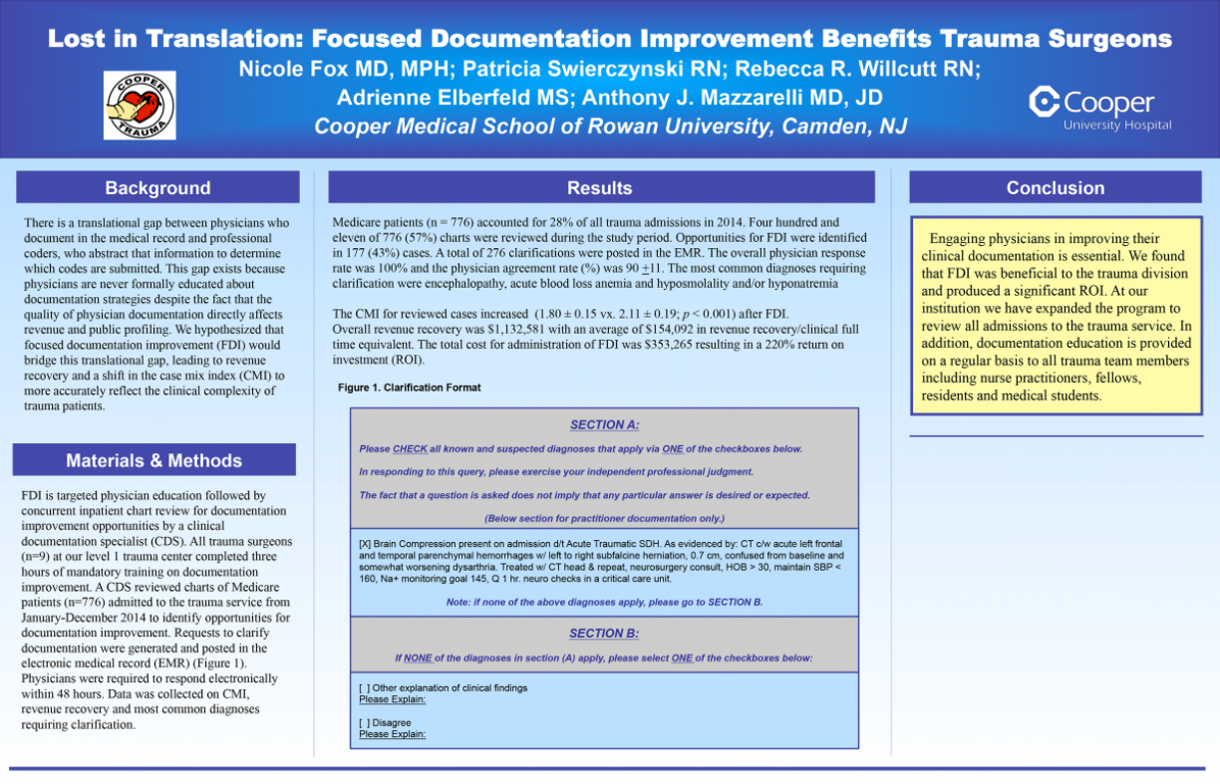
5. Results – Example
In this example, the results are presented as text.
Consider developing a table or figure to create more impact.

Slide 18
6. Conclusions
Brief and relevant
Answer the question posed in the introduction
Suggest future research
No need for a full discussion (leave it for the manuscript)
Don’t repeat the results
In this example, the conclusion repeats the results and loses impact.

Slide 19
6. Conclusions – Example
Implementation of a new, to our hospital setting adapted algorithm for children with mild TBIs was followed by a highly significant reduction of skull x-rays from 1 out of 3 down to 1 out of 10 patients. No life-threatening events were missed and no higher number of re-admissions was observed. We conclude, that using the new, differentiated algorithm can avoid a majority of unnecessary skull x-rays without loosing any diagnostic quality. Therefore children with mild TBIs can be protected from needless radiation and unnecessary costs can be avoided.
88 words
Implementing a new, setting-specific algorithm for children with mTBIs significantly reduced the requirement for skull x-rays, without losing diagnostic quality, thereby protecting patients from needless radiation and avoiding unnecessary costs.
30 words

Slide 20
7. References
Always cite numbers in text
Limit to only relevant references
In reference list, present as:
First author et al
No publication title
Vancouver style
In this example, there are 10 references and they are presented in full the reference list takes up a significant proportion of the poster.
See how to improve in the next slide.

Slide 21
7. References – Example
Edwards NW, Fabian TC, et al. Antithrombotic therapy and endovaxcular stents are effective treatment for blunt carotid injuries: results from longterm followup. Journal of the American College of Surgeons. 2007;204(5):1007-13; dicussion 14-5.
Miller PR, Fabian TC, et al. Prospective screening for blunt cerebrovascular injuries: analysis of diagnostic modalities and outcomes. Annals of Surgery. 2002;236(3):386-93; discussion 93-5.
Cothren CC, Moore EE, et al. Anticoagulation is the gold standard therapy for blunt carotid injuries to reduce stroke rate. Arch Surg. 2004;139(5):540-5; discussion 5-6.
Stein DM, Boswell S, et al. Blunt cerebrovascular injuries: does treatment always matter? J Trauma. 2009;66(1):132-43; discussion 43-4.
…
Edwards NM et al. J Am Coll Surgeons 2007;204:1007-13.
Miller PR et al. Ann Surg 2002;236:386-93
Cothren CC et al. Arch Surg 2004;139:540-5.
Stein DM et al. J Trauma 2009;66:132-43.
Emmett KP et al. J Trauma 2011;70:1058-63.
Bill WL et al. Ann Surg 2002;235:699-706
Cothren CC et al. Arch Surg 2009;144:685-90.
DiCocco JM et al. J Trauma Acute Care Surg 2013;74:755-60.
Byrnes MC et al. J Emerg Surg 2012;7:25.
Kitagawa RS et al. J Neurosurg 2013;119:324-31.

Slide 22
8. Tables and figures
Combine figures and tables (aim for a total of 5)
Use unusual figure formats and graphics
Simplify tables
Do not duplicate information
Use color creatively
In this example, there are 5 tables, 3 graphs and numerous images making the poster cluttered and unfocussed

Slide 23
9. To summarize
Poster needs to be eye-catching
Be creative (use colors and unusual formats)
Minimize the number of words (maximize the font size)
Locate tables and figures near relevant text
Important information should be readable from about 3 meters

Slide 24
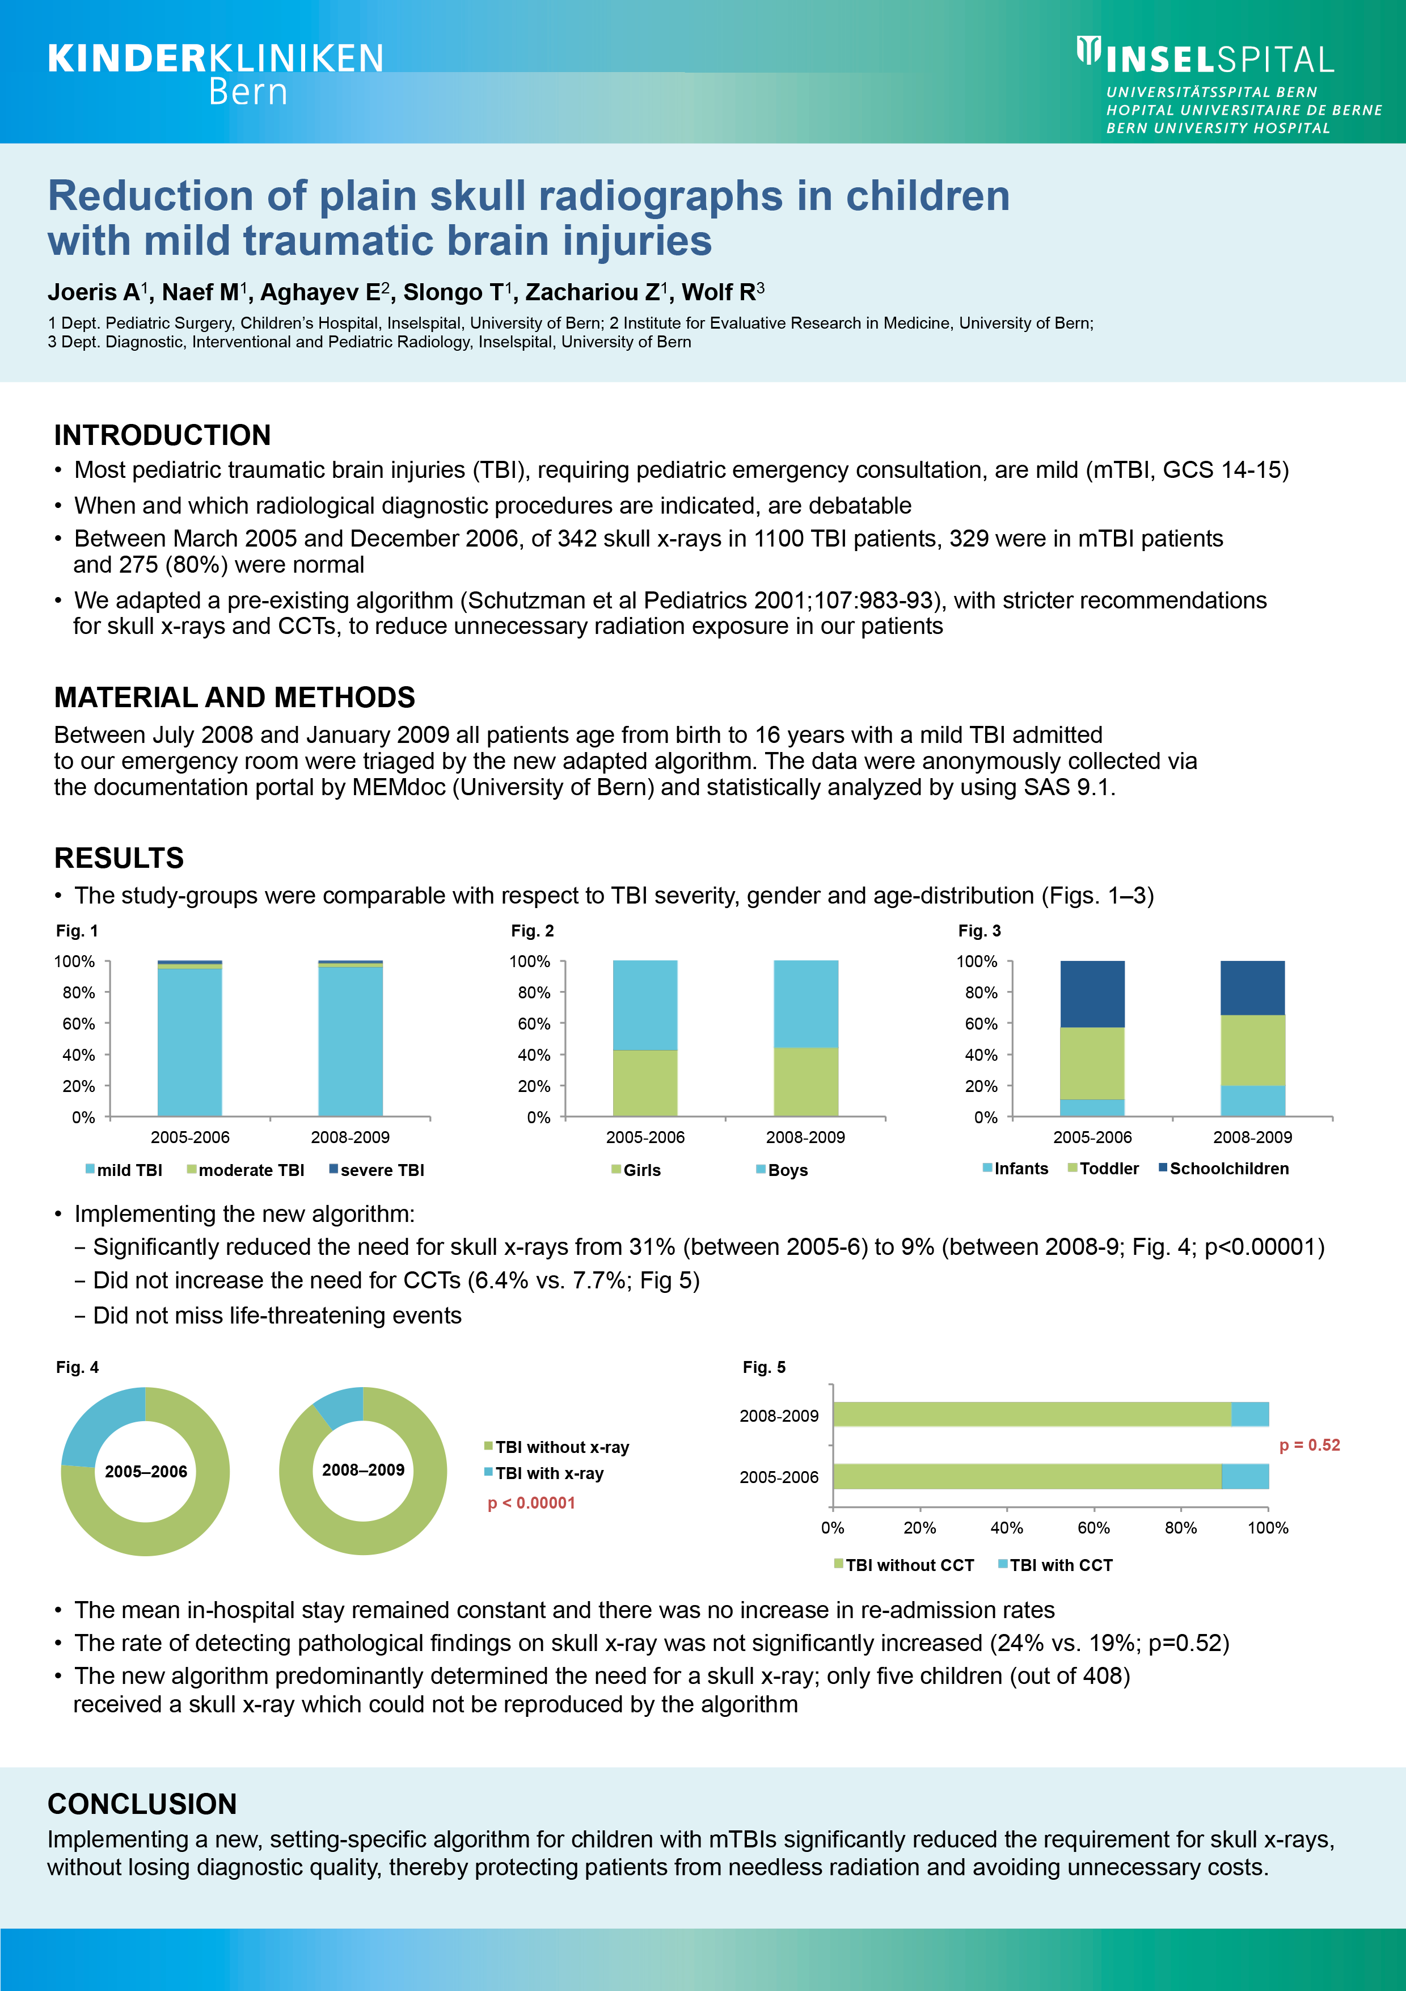
Making a few changes, for example by removing non-essential words and introducing structure can make even a good poster easier to read (and therefore more likely to be read).

Slide 25
Additional resources
The following websites include useful practical tips for poster presentation (accessed 20th September 2016):
https://www.ncsu.edu/project/posters/
http://www.nuigalway.ie/remedi/poster/media Posters_Good_and_bad.pdf

Slide 26
Disclaimer
This document may be used for educational and research purposes or personal use only. None of this material may be used for any commercial use nor is it permitted to create any derivative works based on the works contained on this site without written permission of the AO Foundation.

